Slide 1
Week 2 Presentation
Group 1:
Dylan Samples, Alex Holmes, Jibin Mathews

Slide 2
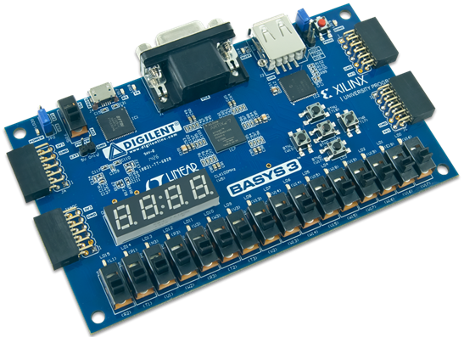
Objective
Make a DC motor that spins both in both directions with variable speeds
Using BASYS FPGA Board
Utilize switches SW0- SW7
Produce current readings and direction on a 7 segment display
Maintain current flow using Shunt Resistors
Implement over-current protection

Slide 3
Deliverables
Safety Trainings Completed
Attended Soldering Training
H-Bridge Motor Drivers Constructed
Vivado Downloaded

Slide 4
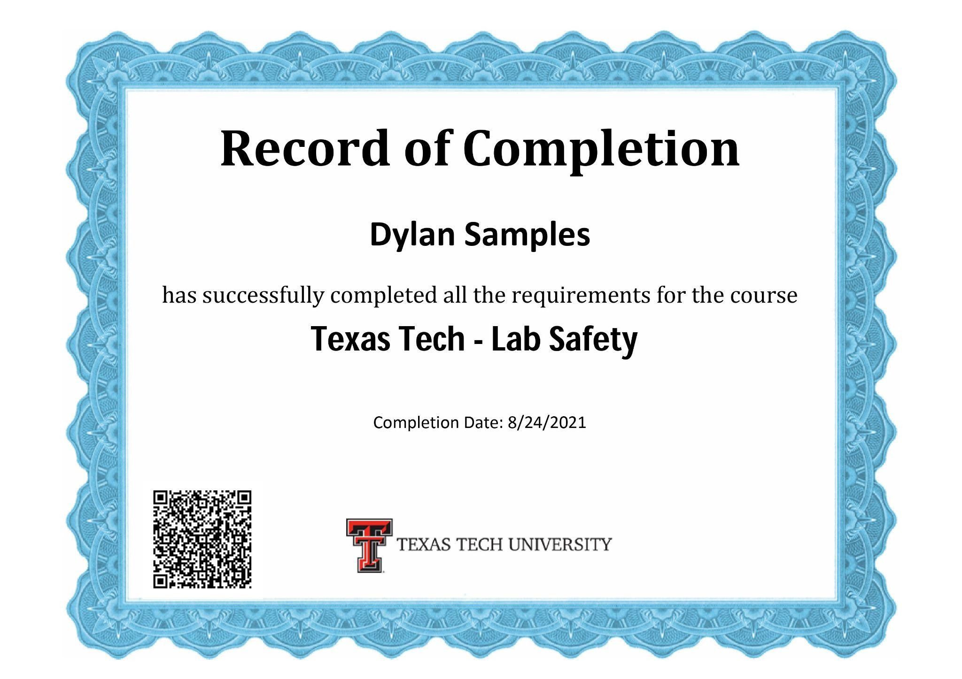
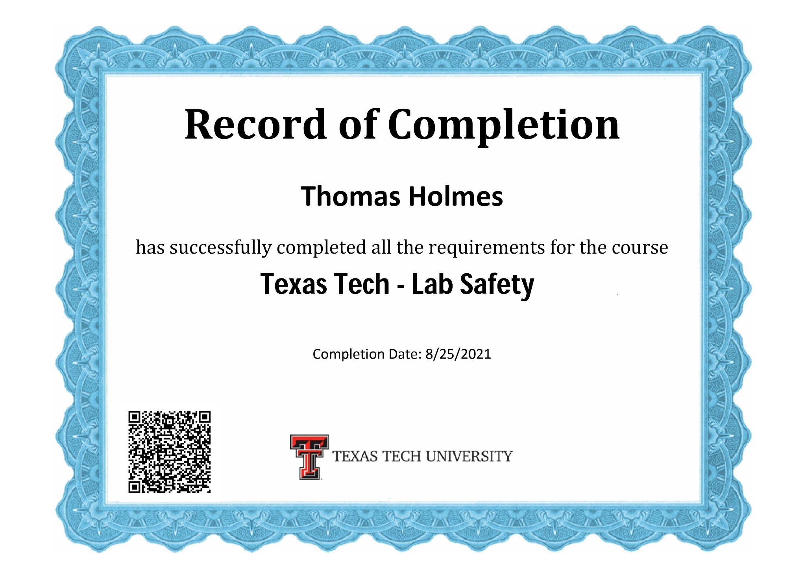
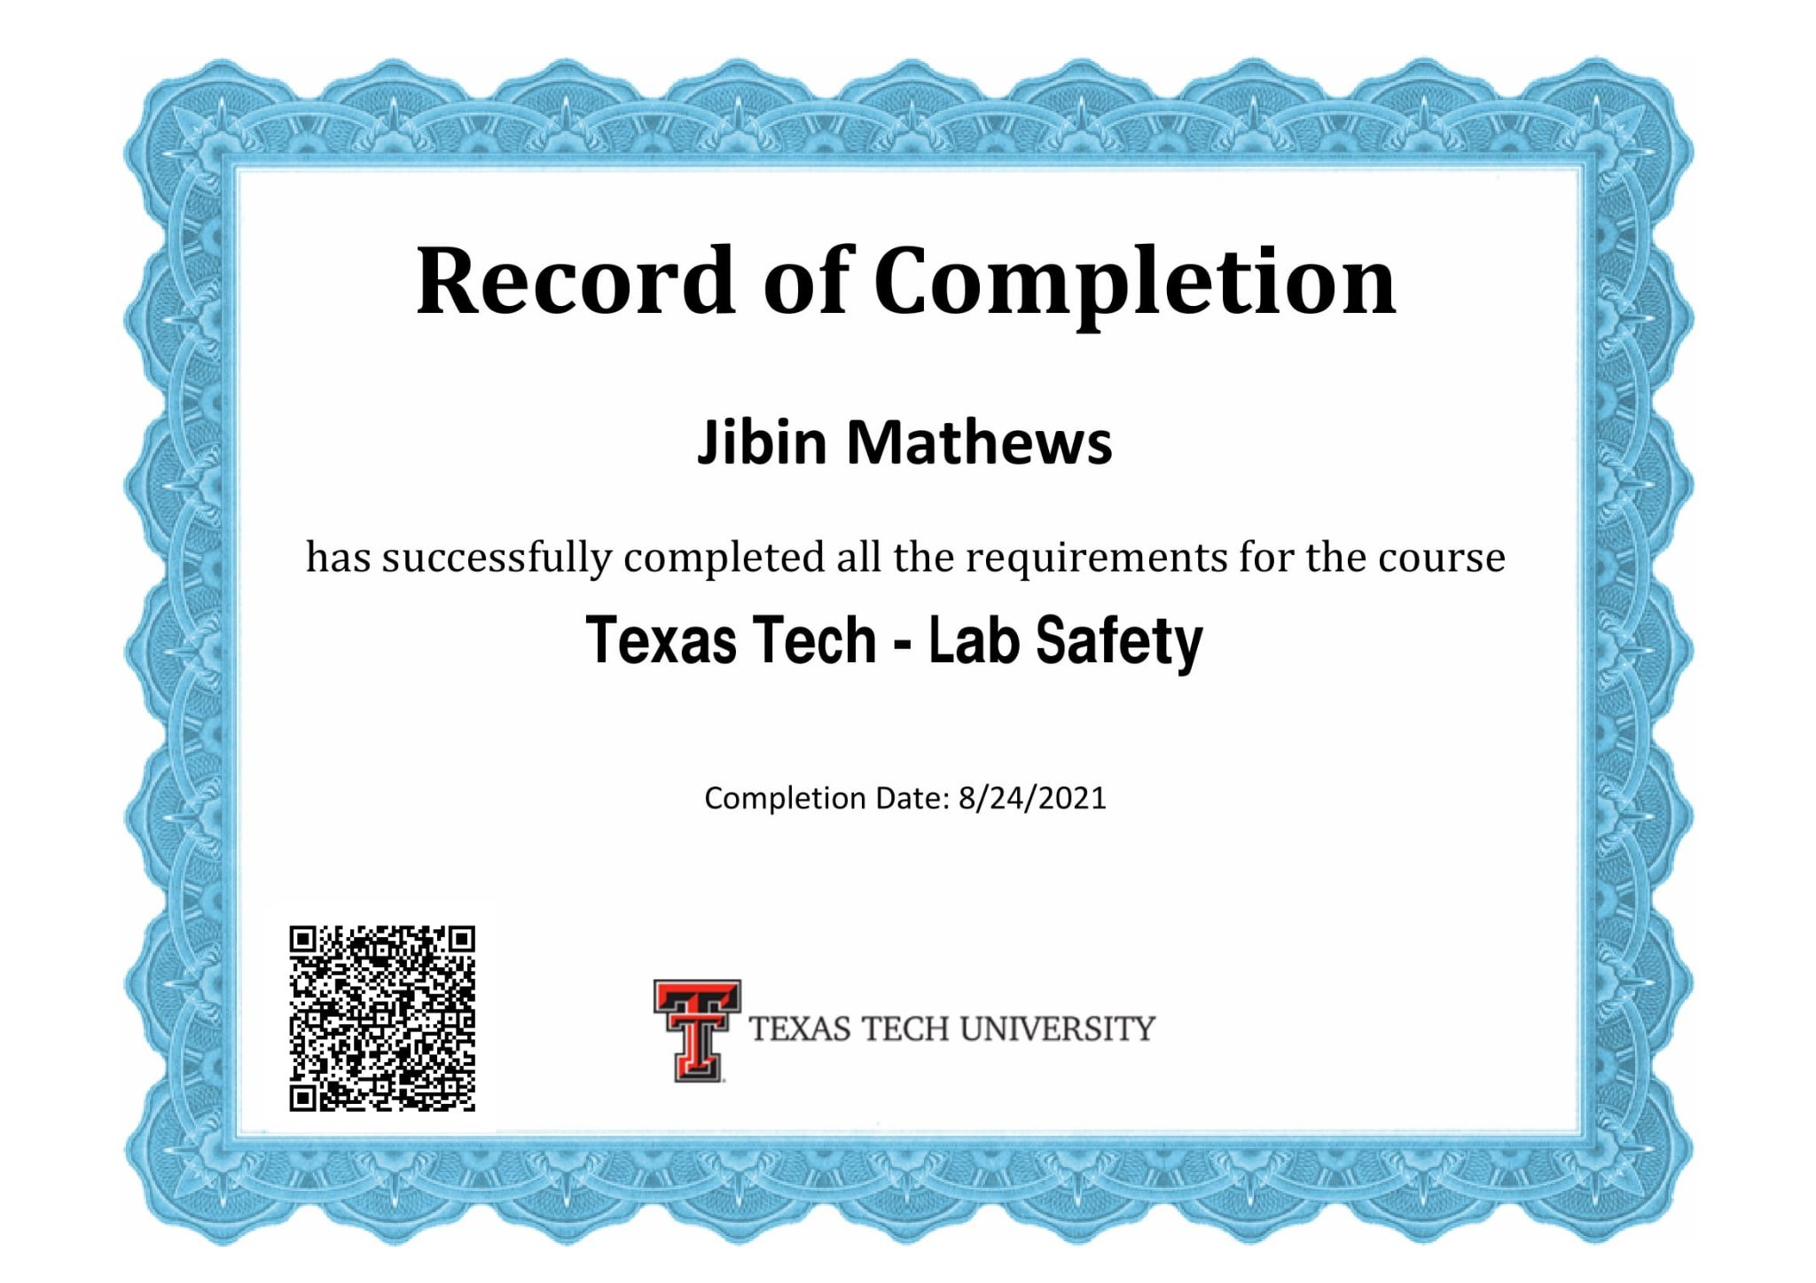
Safety Training Certificates
Lab Safety ✅
Hazard Communication ✅
Stockroom Safety Quiz ✅

Slide 5
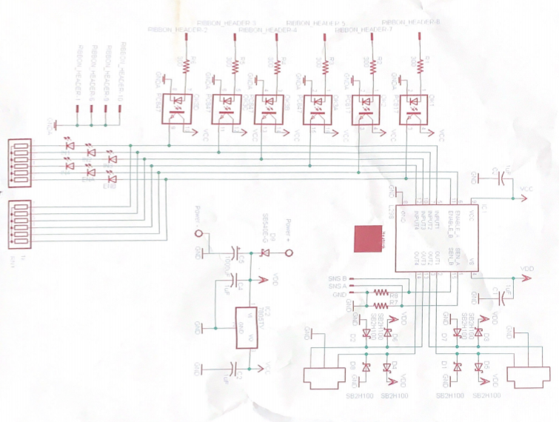
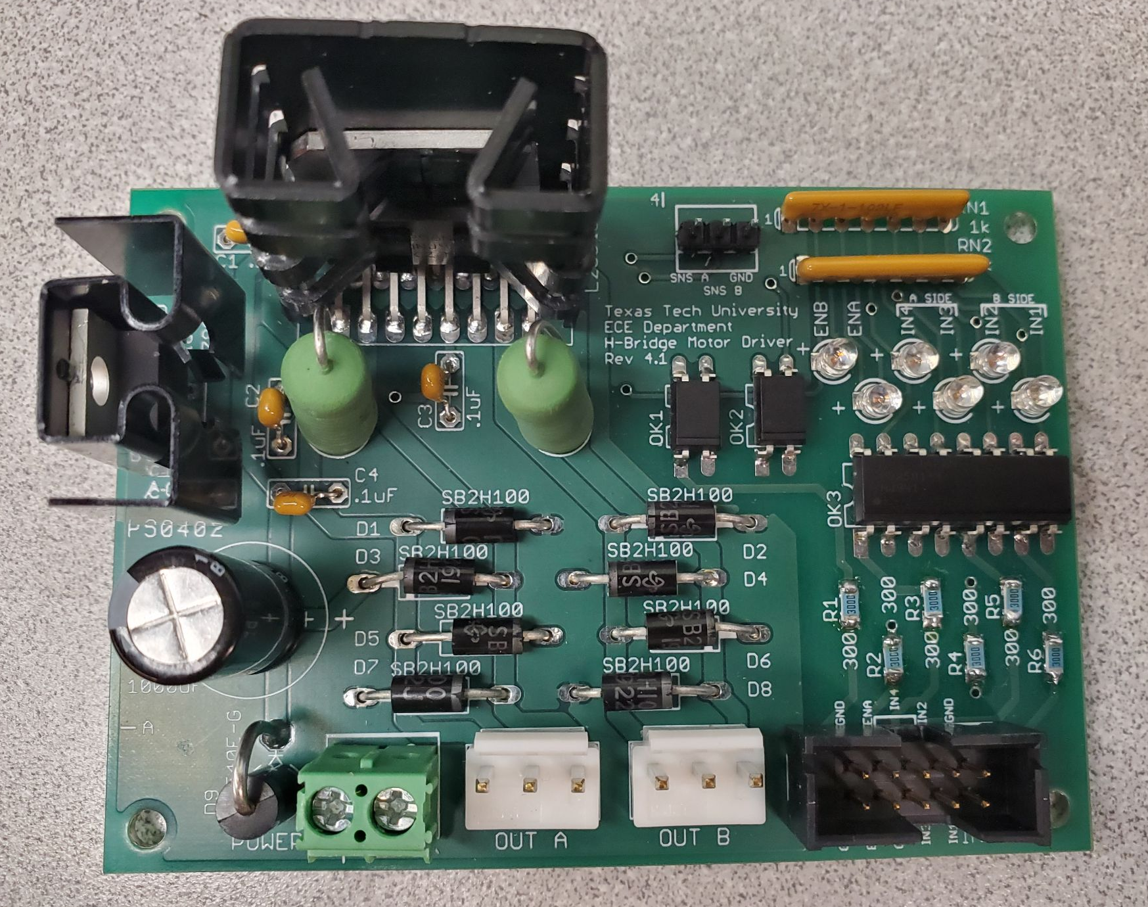
H-Bridge Motor Driver and Schematic

Slide 6
Budget
Budget Mini Project | Cost: | Total Spent:
H-Bridge Motor Driver | $23.53 | $0.00 |  | Material Costs | Cost: | Total Spent:
L298N | $6.50 | $0.00 |  |  | $196.06 | $0.00
Linear Voltage Regulator | $1.79 | $0.00
Optocouplers | $1.40 | $0.00 |  | Labor | Rate | Hours Spent
Resistors | $3.28 | $0.00 |  |  | $15.00 | 15
Diods | $5.90 | $0.00
Capacitors | $2.12 | $0.00 |  | Totals | Total Cost: | Actual Cost:
Board | $0.40 | $0.00 |  |  | $421.06 | $225.00
Connectors | $2.14 | $0.00
BASYS FPGA Board | $149.00 | $0.00

Slide 7
Next Week's Deliverables
Attend Solder Tutorial 2 / Fix Problems with H-Bridge Motor Driver
Get a Workbench
Obtain Supplies
Assemble Mini Project
Program Mini Project

Slide 8
Gantt Chart
Mini Project | Week 1 | Week 2 | Week 3
Hardware
H-Bridge Motor Driver
Basys Board W/ Motor
Full Assembly
Programming
Research
Download / Installation
Actual Code

Slide 9
Questions
?

